Slide 1
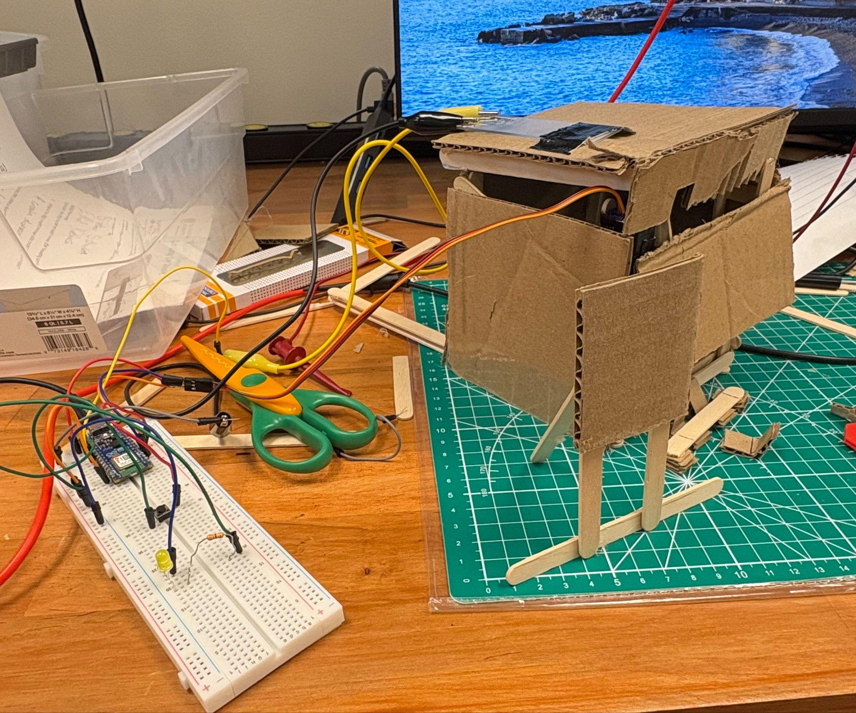
Automated Awning
System
Brenton Schneider, Elliott Robbins, William Cariveau
Notes:
This is our project. We designed an automatic awning that opens when it is raining, and shuts when it isn’t.

Slide 2
Introduction and Overview
Requirements
Constraints
Our Project
System must improve quality of life
Two input sensors
Two outputs
Limited materials
3 Class days to work
Inputs: Custom sensor + button
Outputs: Servo motor + LED
Notes:
The project required us to create a prototype of a system that interacts with people, and improves quality of life.
Our design was to create an automated awning system, that opens when the humidity is high, meaning it will rain soon. The design of out awning was similar to that of the alarm we all designed, where it only opens when a button has been clicked and it is raining. The awning goes back down after the humidity has lowered or if the button if clicked off. This protects customers from the rain, but also allows them to enjoy the sun while its shining. For the prototype, we were required to implement two inputs, one of which must have been the humidity sensor we designed in lab. We chose to use a button for the other input. Additionally, we were required to have two outputs, one of which must be an LED, and the other a motor. We chose to use a servo motor to move the actual awning itself.
One constraint we ran into was we only had limited materials. We constructed the building out of cardboard and popsicle sticks. Another constraint was we only had 3 class periods to work on the project, limiting the extent of what we could create.

Slide 3
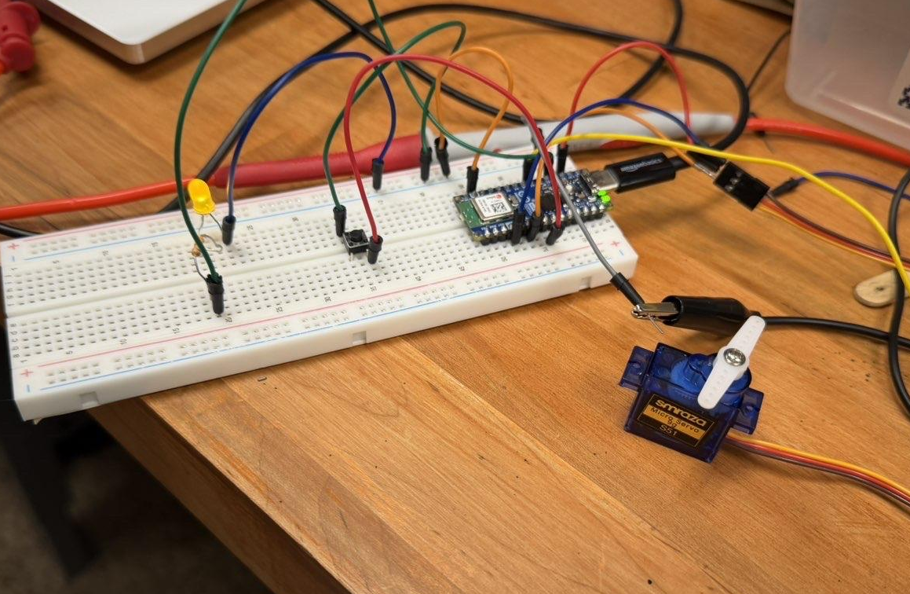
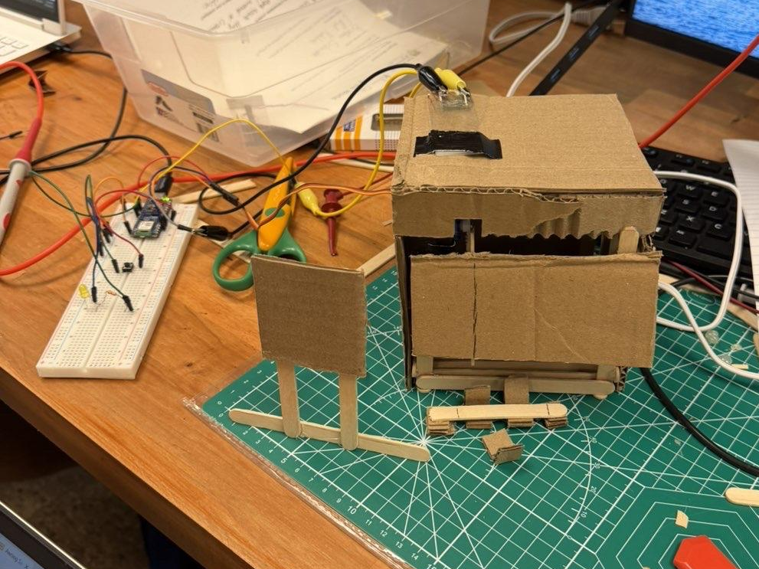
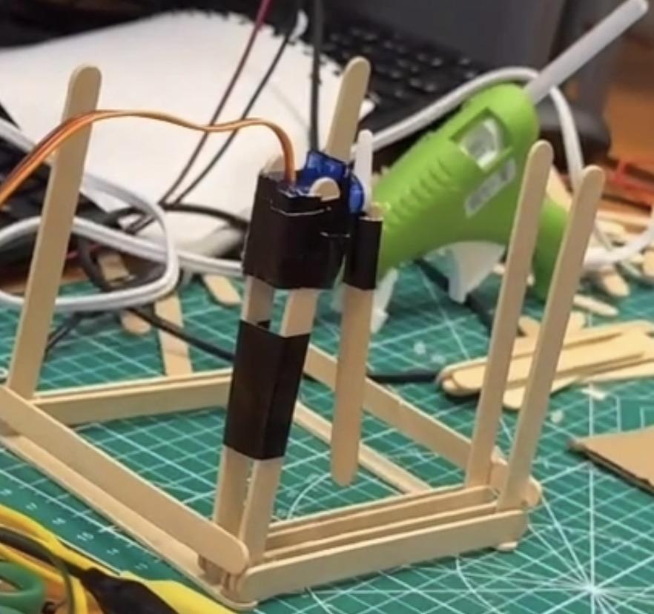
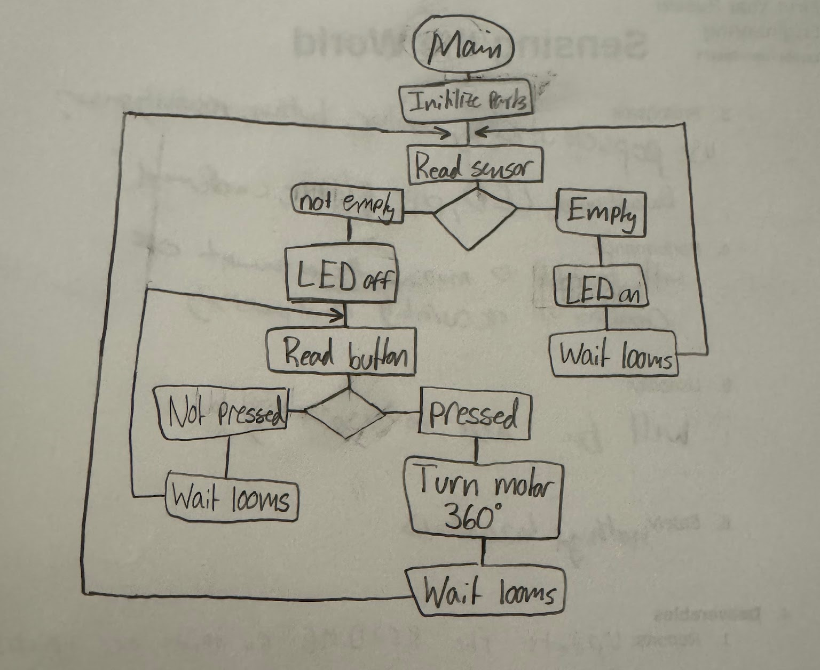
Implementation Overview
01
02
03
04
Planning
Prototype
Brainstormed
Tried first idea
Learned and tried new idea
Built store
Integrated code
Test Code
Finalize
Light
Button
Motor
Custom sensor
Combine code
Finish building
Notes:
We started by brainstorming how we could implement all the required components into our project idea, which was an automatic protein powder dispenser. We thought the resistivity of the sensor would change due to the dryness in the protein powder, however we were wrong and had to switch ideas. So we decided to build an awning
After we had our new idea planned and brainstormed we cycled between wiring the electronic components (light, button, sensor) and creating code for them. We first tested our light, then we tested to make sure whenever our button was pressed that our light would stay on/off, then we made code for our motor to rotate 90 degrees when the light was on, and finally we used the sensor to track our humidity readings to toggle the awning.
Next we built our structure using popsicle sticks, duct tape, and hot glue as shown in the picture.
After this, we integrated our code and electronics to see how it would work with the physical components of this project to create the final project.

Slide 4
Use of AI
01
Test Codes
02
Moisture Testing
03
Final Code
Set up a base for light and button code
Used AI code to give us moisture readings
Combined the light code with moisture code
Notes:
We used AI for three major things;
The first was creating code where the button operates as a switch, turning on or off the LED. The LED being on meant the system was on, which meant we also wanted to test and make sure the motor rotated 90 degrees a few seconds after the LED was on. Once the LED was off meant the system should turn off, which meant the motor should rotate back to its original position.
The second major step was using our custom made sensor to control the awning. We took our ADC program and used it to see what happened to the voltage when we blew on it versus when we didn’t. We found that when we blew on it, the voltage was zero and with no blowing on it the voltage would be a low amount. Knowing that we used AI to ask it to make us code when the voltage was zero to prop the awning up and when the voltage was non zero to leave the awning rested. The biggest problem we found with this step was that sometimes our sensor would randomly read 0 when no one was blowing on it, however, we found that by blowing on it the voltage would read 0 for a longer period of time and structured our code in a way that the awning would prop up only if the voltage was 0 for a set time.
Finally, it was time to integrate our light and moisture code. We wanted to make sure the awning was propped up only if the LED was on AND the voltage coming from our custom sensor was equal to zero.

Slide 5

Results

Slide 6

Overall…
We created a successful prototype
We built technical skills and soft skills
Had a lot of fun
Notes:
Overall this project was a success, we created a working prototype that meant the requirements as we used our sensors as inputs to track moisture and turn the system on/off. We had our outputs in the motor and the LED. Built a prototype within our limited resources and would help people
We learned a lot: how to use our Arduino ESP32 and code with it in micropython, how to use basic electronic components such as resistors, LEDs, buttons in a circuit, and how to use AI in
But we also learned how to communicate with each other as a group making sure everyone’s voice was heard and how to take initiative in the project
And had a lot of fun during the whole process as well

